Slide 1





ROS2 Navigation
Nav2 Costmap 2D
July-15 2023

Slide 2
2
Outline
Nav2 Costmap 2D Introduction
Nav2 Costmap 2D Framework
Nav2 Costmap 2D Layers
Nav2 Costmap 2D Static Layer
Nav2 Costmap 2D Obstacles Layer
Nav2 Costmap 2D Inflation Layer
Nav2 Costmap 2D Visualization Tool
Nav2 Costmap 2D Q&A
Summary

Slide 3
Nav2 Costmap 2D Introduction
3

Slide 4
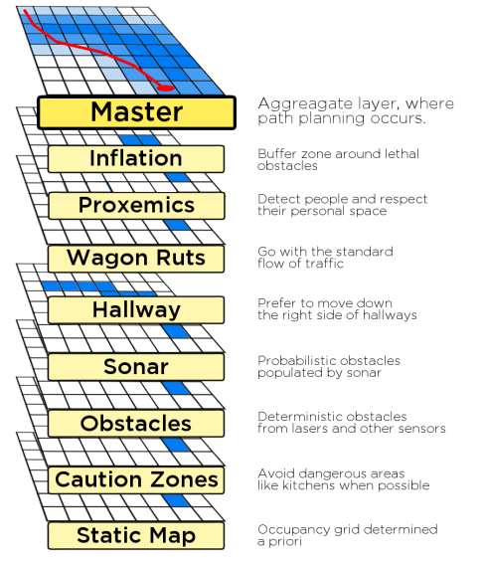
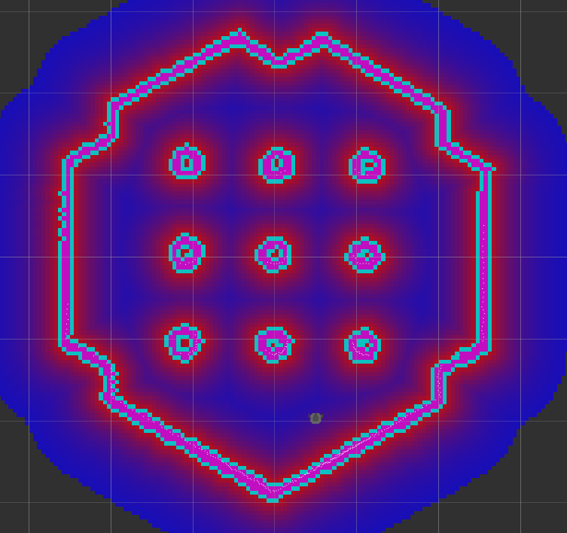

4
Nav2 Costmap 2D Introduction
Monolithic Costmap
Layers in the Costmap
Static Map Layer
Obstacles Layer
Voxels Layer
Inflation Layer
Sonar Layer
Caution Zones Layer
Benefits
Clearer Update Step
A stack of costmap layers, showcasing the different contextual behaviors achievable with the layered costmap approach.
Ordered Update Process
Flexible Configurations
https://ieeexplore.ieee.org/stamp/stamp.jsp?arnumber=6942636

Slide 5
Nav2 Costmap 2D Framework
5

Slide 6
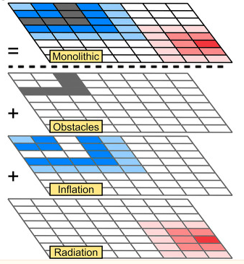
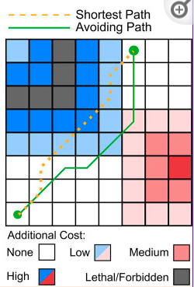
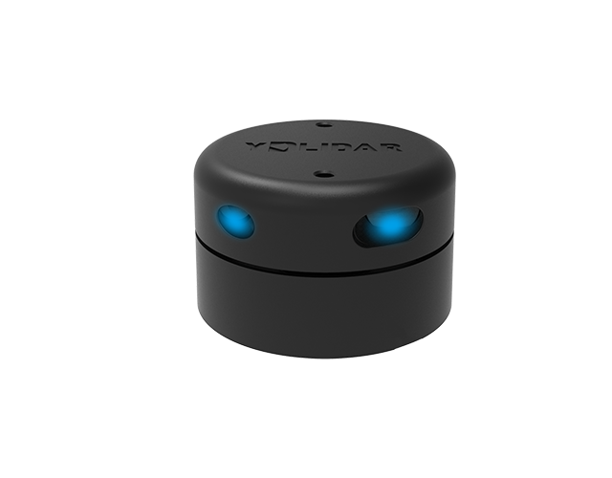
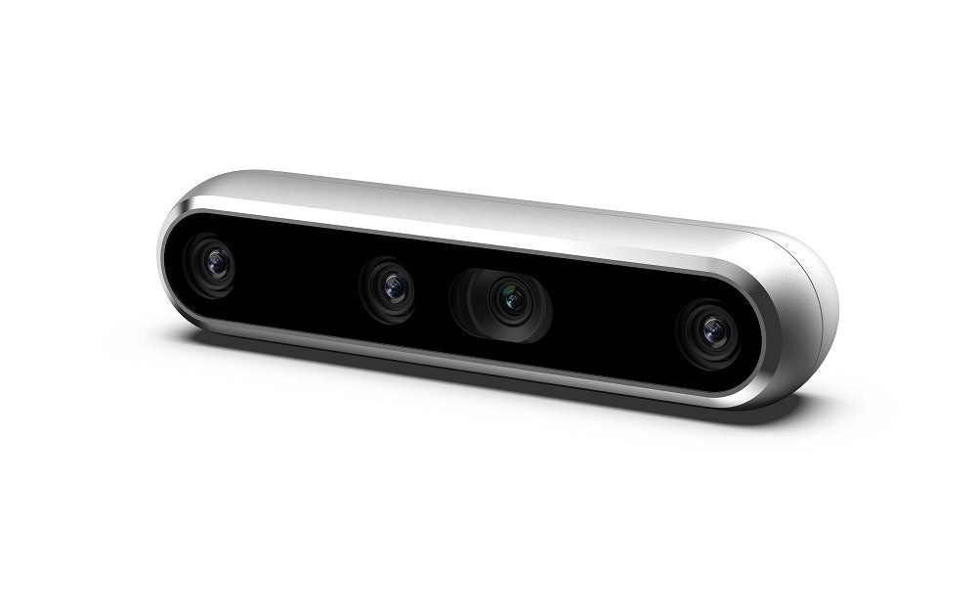
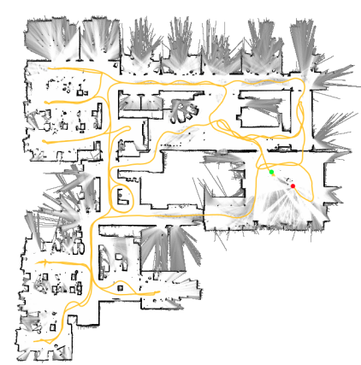
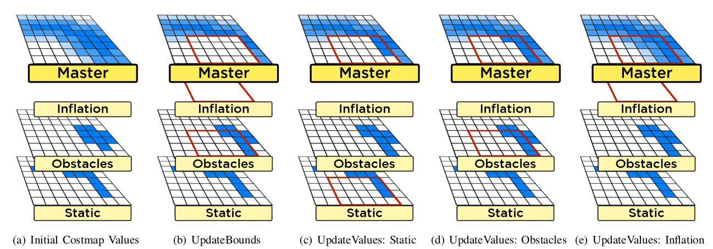
6
Nav2 Costmap 2D Framework
Master Map
Thread
sensors
mapUpdateLoop
frequency
planning
SLAM
Costmap2D ROS
updateBounds
Data source
Path Planning

Slide 7
7
Nav2 Costmap 2D Framework
Costmap initialization
根据配置文件yaml加载各个Layer并初始化
Static Layer
Inflation Layer
坐标系转换
base_link->map/odom
Obstacle Layer
加载参数
加载参数
更新本层地图信息
load all layers
addPlugin
订阅map数据
更新本层的地图信息（master map保持一致）
setting footprint
setRobotFootprint
incomingMap
laserScanCallback
start updateMap thread
监听map的，更新地图分辨率、高和宽
创建observation buffer
转为pointcloud，放入observation buffer中
mapUpdateLoop
publish costmap
publishCostmap
保存数据到本层的costmap_中
注册不同传感器的回调函数
更新bservation buffer中过时的数据

Slide 8
Nav2 Costmap 2D Layers
8

Slide 9
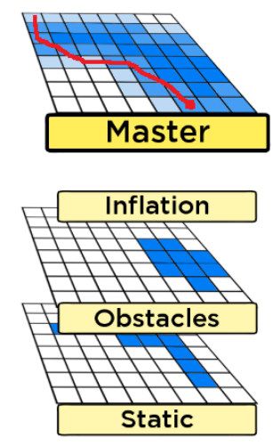
8
Nav2 Costmap 2D Layers
Standard Layers
Static Map Layer: This layer takes in a generated map. At start, values are directly written to the Master Costmap.
Obstacle Layer: This layer does online “object detection“. The
space between the sensor and the sensor reading is marked as
free, and the sensor reading’s location is marked as occupied.
Inflation Layer: Inserts a buffer zone around each lethal obstacle. Collision is marked with a lethal cost Immediate surrounding with
a small non-lethal cost

Slide 10
Nav2 Costmap 2D Static Layer
9

Slide 11
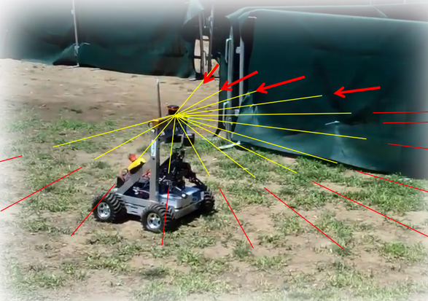
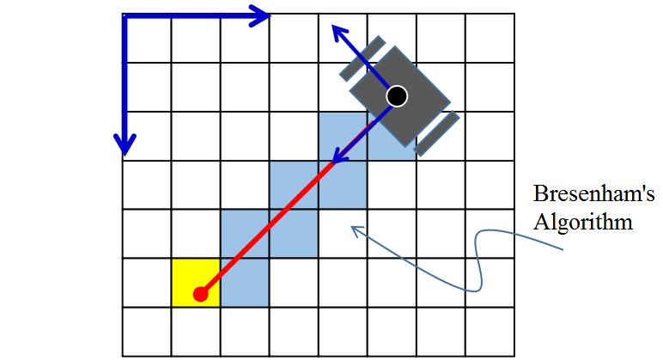
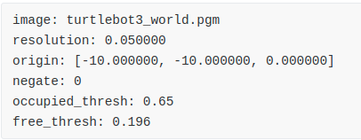

10
Nav2 Costmap 2D Static Layer
Occupancy Grid Map
map ymal
nav_msgs/OccupancyGrid

Slide 12
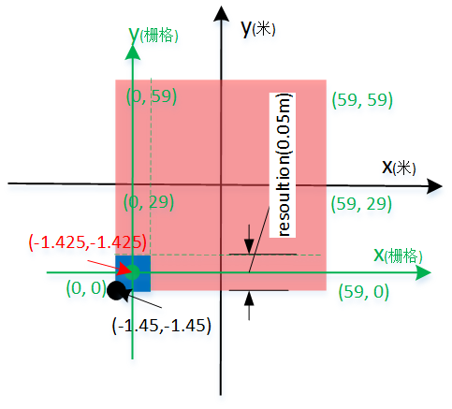
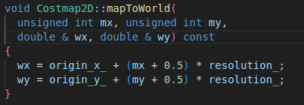
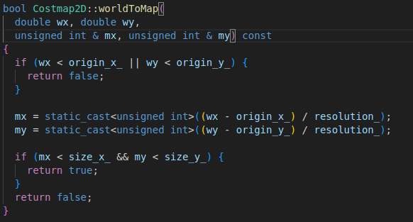
10
Nav2 Costmap 2D Static Layer
Map coordinate system
mapToWorld
worldToMap
map坐标系原点在该区域左下角坐标(origin_x_, origin_y_)附近。
具体是在(origin_x_ + resolution/2, origin_x_ + resolution/2)
map坐标系坐标单元是栅格，只有整数才有意义
一个栅格表示一个resolutin x resolution面积的真实区域，栅格坐标
对应的world坐标是在该栅格的中心点坐标
map区域，即x范围是[0, size_x_-1]，y范围是[0, size_y_-1]

Slide 13
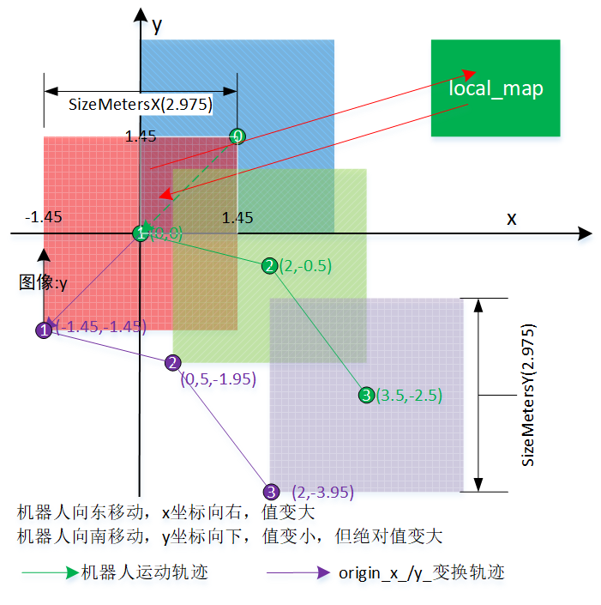
11
Nav2 Costmap 2D Static Layer
World coordinate system
world坐标系原点一般和/map坐标系的原点重合，对应真实世界中机器人中心在开始时刻落在的那个位置
world坐标值是此刻机器人中心点距离初始位置的偏移
world坐标单元往往叫栅格，一个单元表示着“resolution x resolution”的真实世界面积。resolution默认0.05m/pixel
world坐标单元中的值，往往和该栅格上存在障碍物的概率相关
world坐标系生成地图图像。生成图像图像原点是在左下角，OpenCV左上角

Slide 14
Nav2 Costmap 2D Obstacles Layer
12

Slide 15
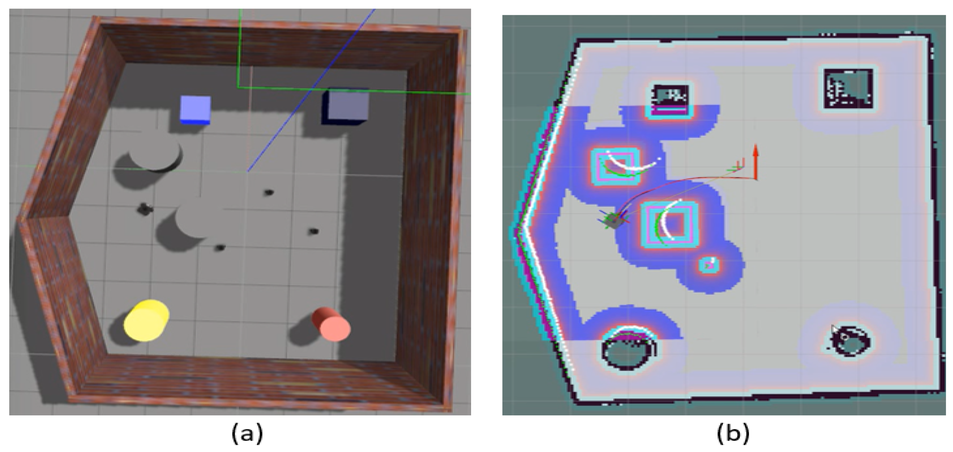
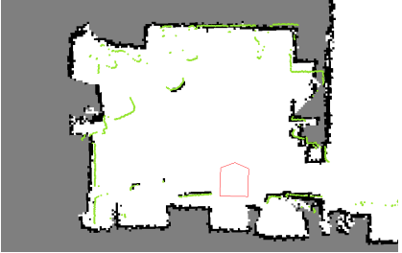
13
Nav2 Costmap 2D Obstacles Layer
Obstacles from sensors
Realsense sensor
Lidar sensor
RGB-D Camera
Figure: Simulation results of the clustering algorithm: (a) A virtual world for robot and obstacle avoidance simulation, (b) the robot and obstacles are represented in the cost map layer.
https://openscholarship.wustl.edu/cgi/viewcontent.cgi?article=1062&context=eng_etds
Figure: Obstacles Layer - Sensor data is shown in green

Slide 16
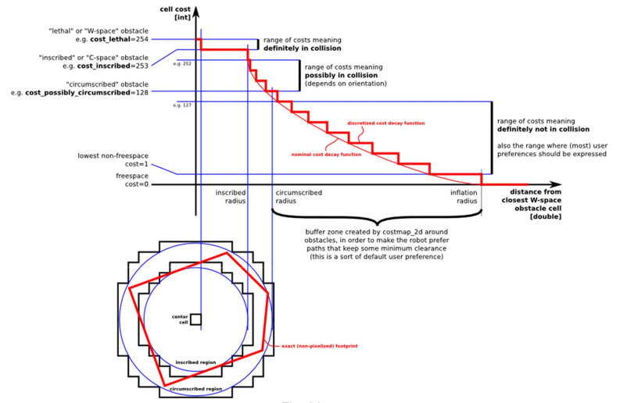
14
Nav2 Costmap 2D Obstacles Layer
Obstacles workflow
updateBounds
清理传感器到被测物体之间的区域
处理测量值越界
raytraceFreespace
将障碍物转化为点云放入observation队列
raytraceLine
根据当前位置更新机器人轮廓
将区域标记为FREE_SPACE
updateCosts
更新障碍物信息到master map
combination method

Slide 17

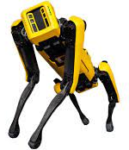

15
Nav2 Costmap 2D Obstacles Layer
updateOrigin
https://www.cswamp.com/post/109
frame transform
Y
robot’s trajectory
origin_x/y transform
X
SizeY
1
微调new_origin_x、new_origin_y，确保
新原点坐标能被resolution_(0.05)整除
(origin_x_, origin_y_)
两个copyMapRegion以及restMaps，生成
新的区域地图
2
(new_origin_x_, new_origin_y_)
SizeX

Slide 18
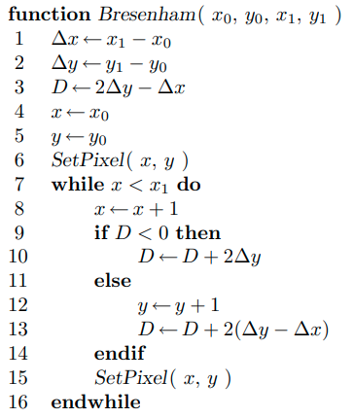
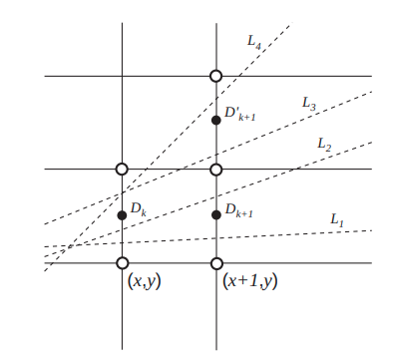
16
Nav2 Costmap 2D Obstacles Layer
Bresenham's algorithm
https://personal.utdallas.edu/~kzhang/BookCG/SlidesChap45.pdf
https://my.eng.utah.edu/~cs5600/slides/Wk%202%20Lec02_Bresenham.pdf
https://www.ics.uci.edu/~gopi/CS112/web/handouts/OldFiles/Bresenham.pdf

Slide 19
Nav2 Costmap 2D Inflation Layer
17

Slide 20
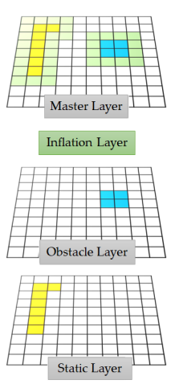
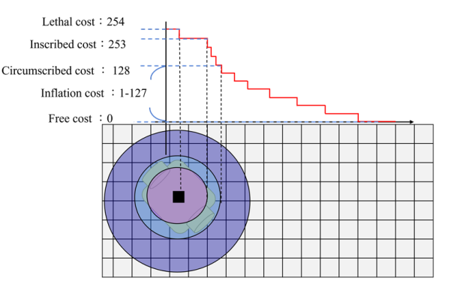
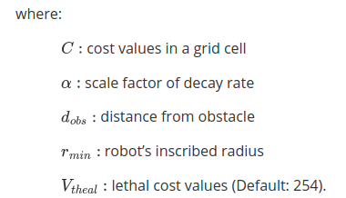
18
Nav2 Costmap 2D Inflation Layer
Inflated layers are updated to the main cost map
Figure: ROS cost map with multiple layers
Velocity Estimation and Cost Map Generation for Dynamic Obstacle Avoidance of ROS Based AMR

Slide 21
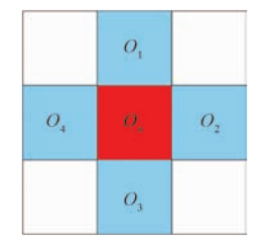
19
Nav2 Costmap 2D Inflation Layer
Inflated layers are updated to the main cost map
updateBounds
维持上一层地图调用updateBounds的值costvalue
Figure: inflation node digram
updateBouds
循环update
updateCosts
根据机器人的尺寸扩张传入的bounds
获取障碍物CELL以及附近CELL的信息装入inflation_queue
处理inflation_queue中的最大distance的cell
计算cost值并更新master map
将cell的四邻域cell塞入inflation_queue
updateCosts

Slide 22
Nav2 Costmap 2D Visualization Tool
20

Slide 23
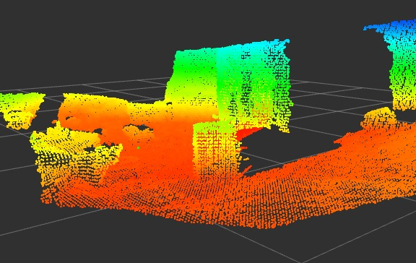
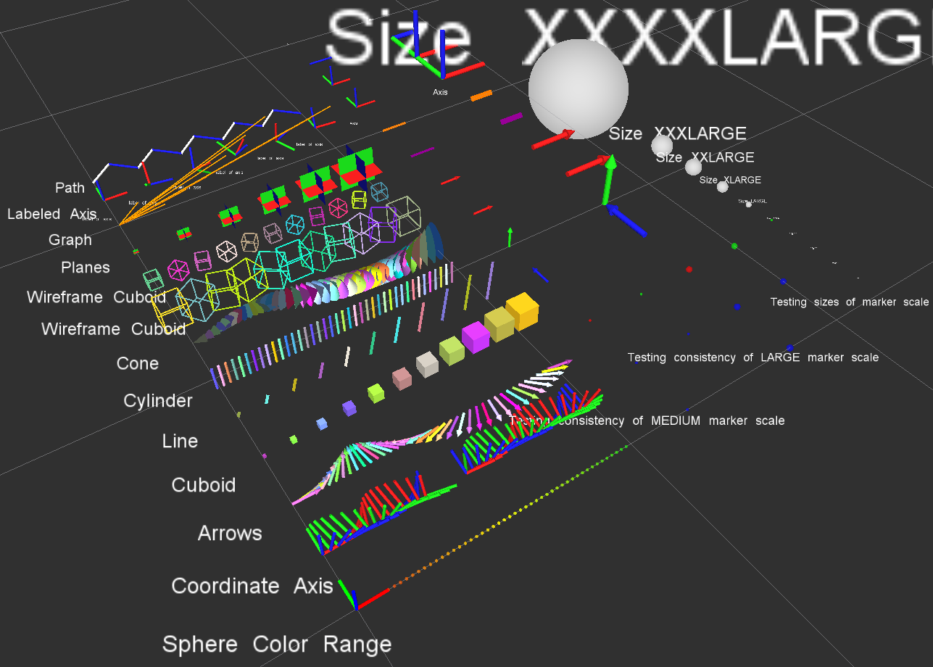
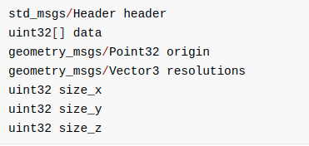
21
Nav2 Costmap 2D Visualization Tool
costmap_2d markers
VoxelGrid.msg

Slide 24
Nav2 Costmap 2D Q&A
22

Slide 25

23
Nav2 Costmap 2D Q&A

Slide 26
24
Summary

Slide 27

25
Summary

